Slide 1
TEXT REPRESENTATION

Slide 2
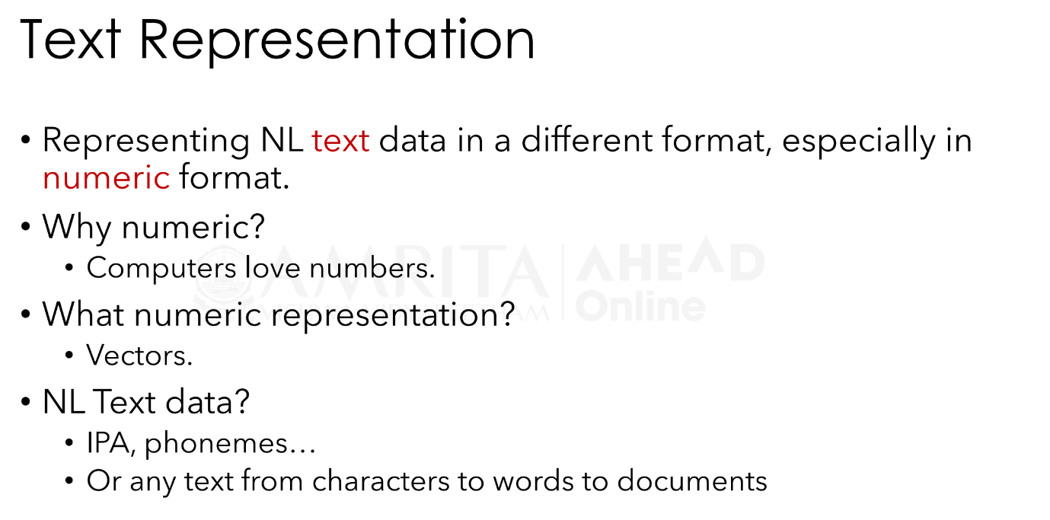

Slide 3
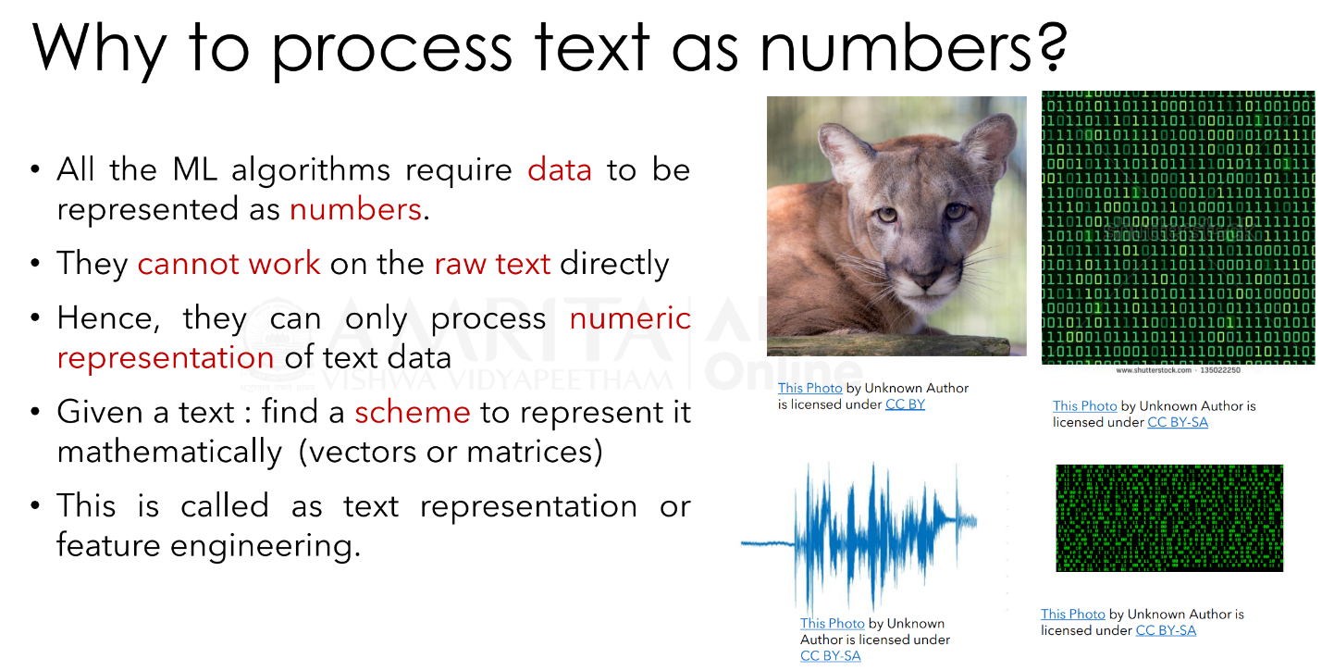

Slide 4
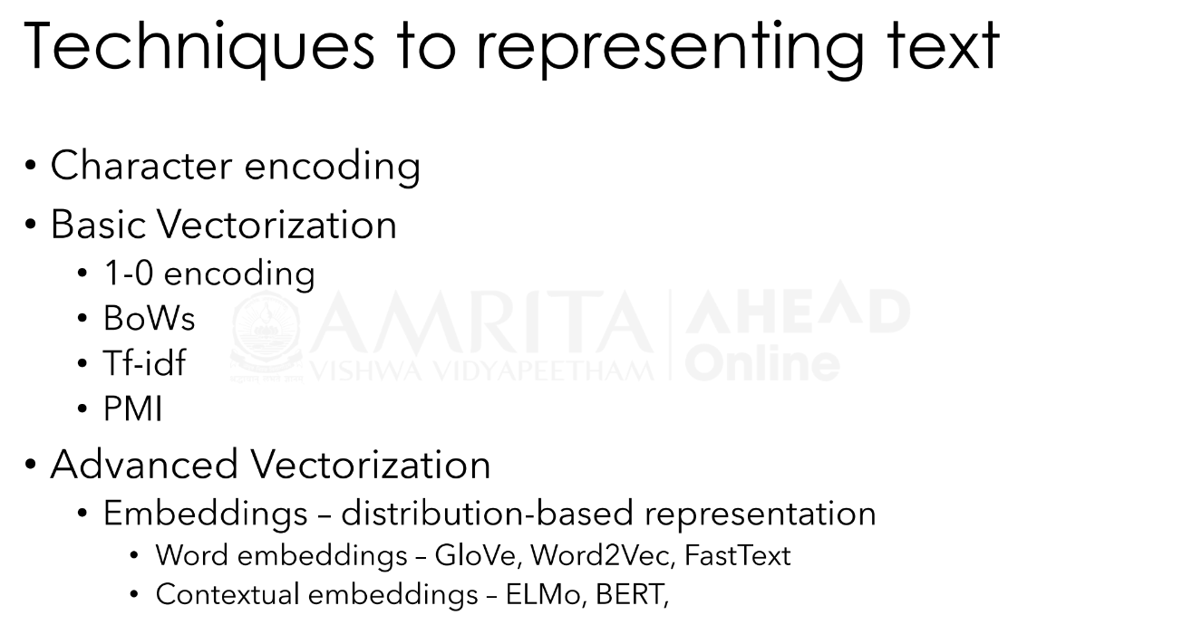

Slide 5
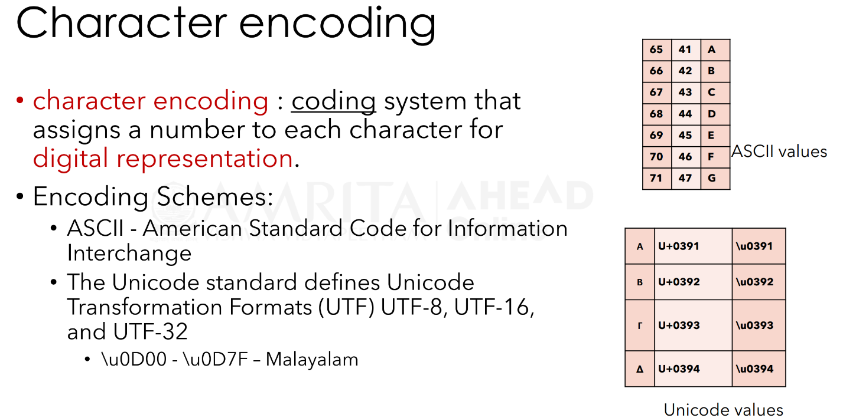

Slide 6
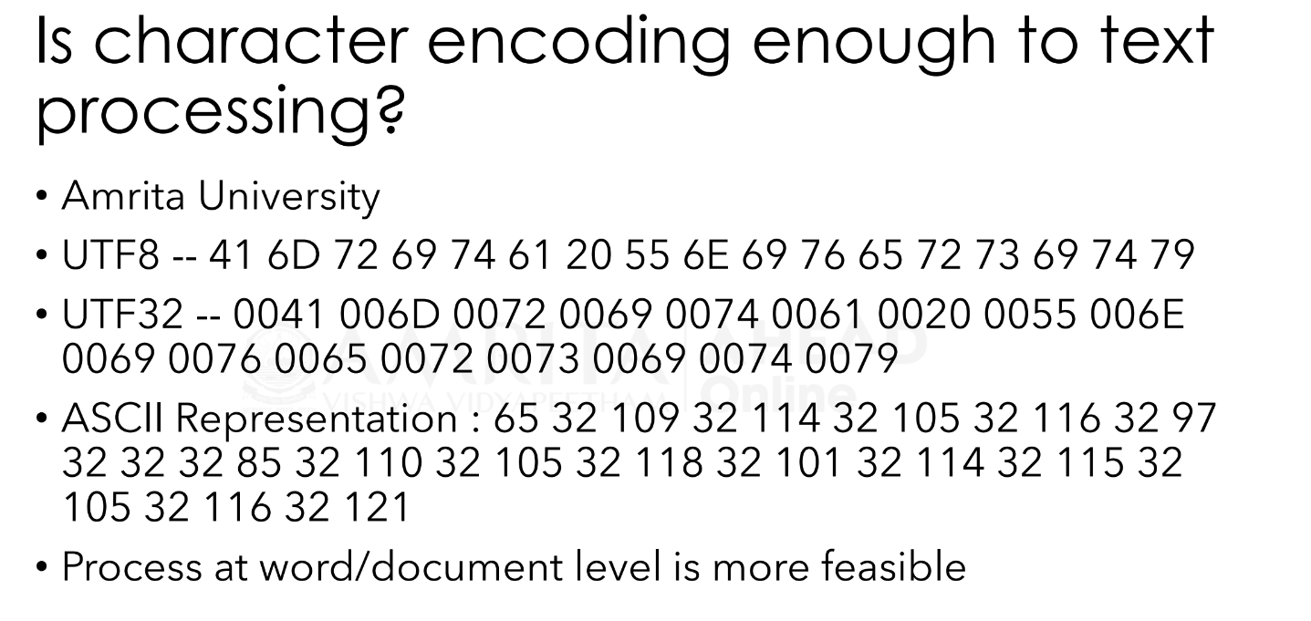

Slide 7
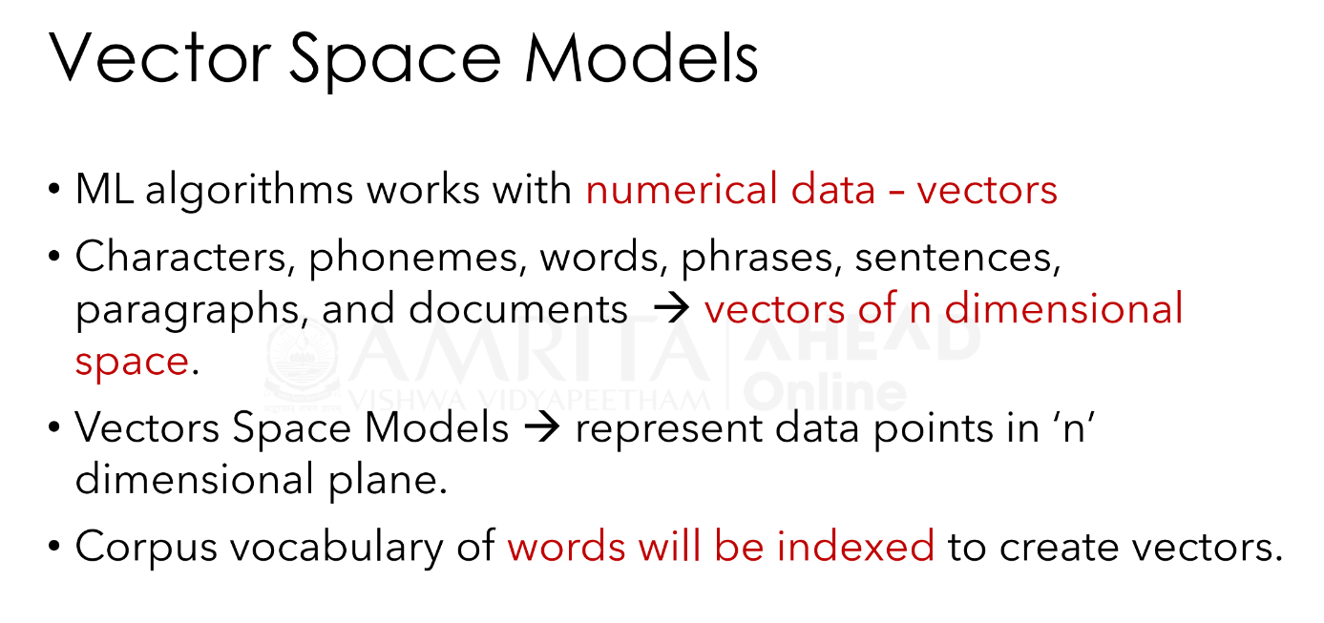

Slide 8
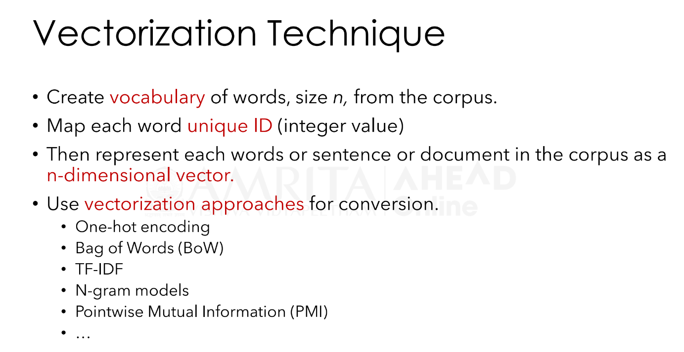

Slide 9
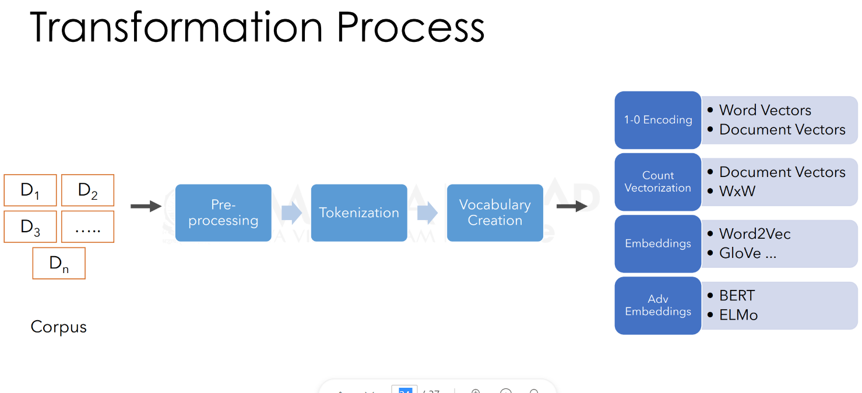

Slide 10
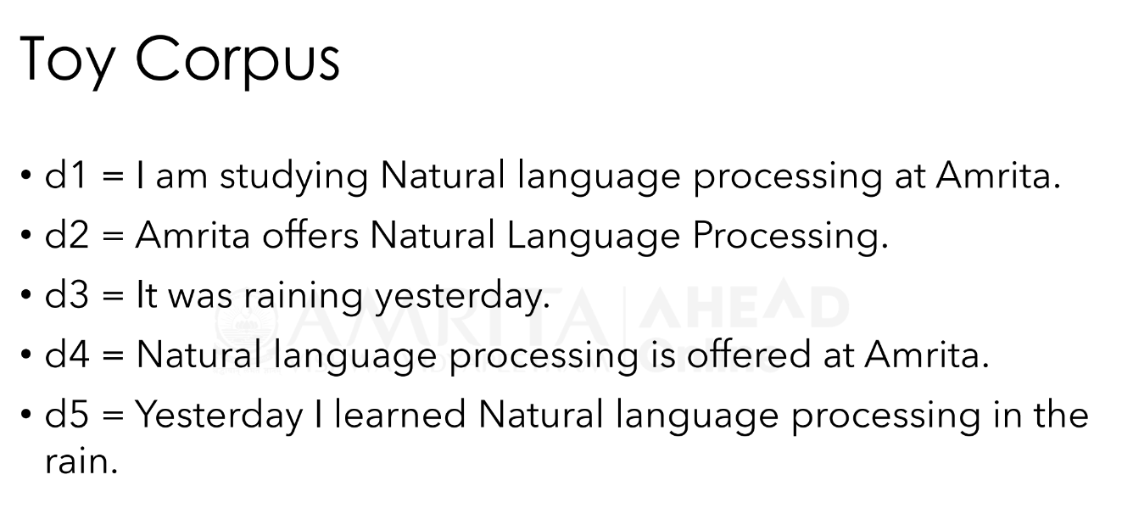

Slide 11
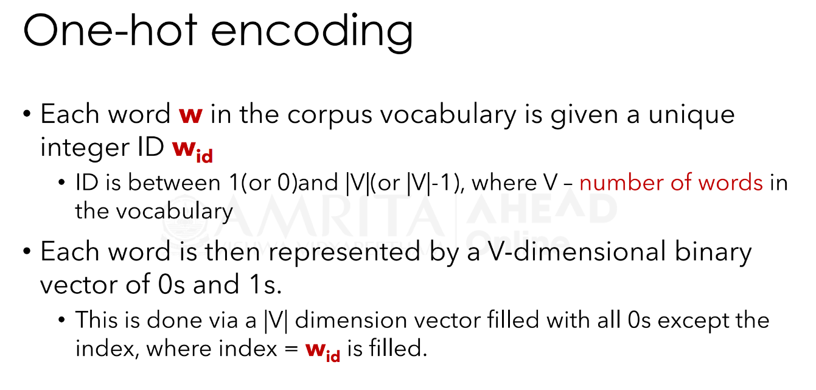

Slide 12
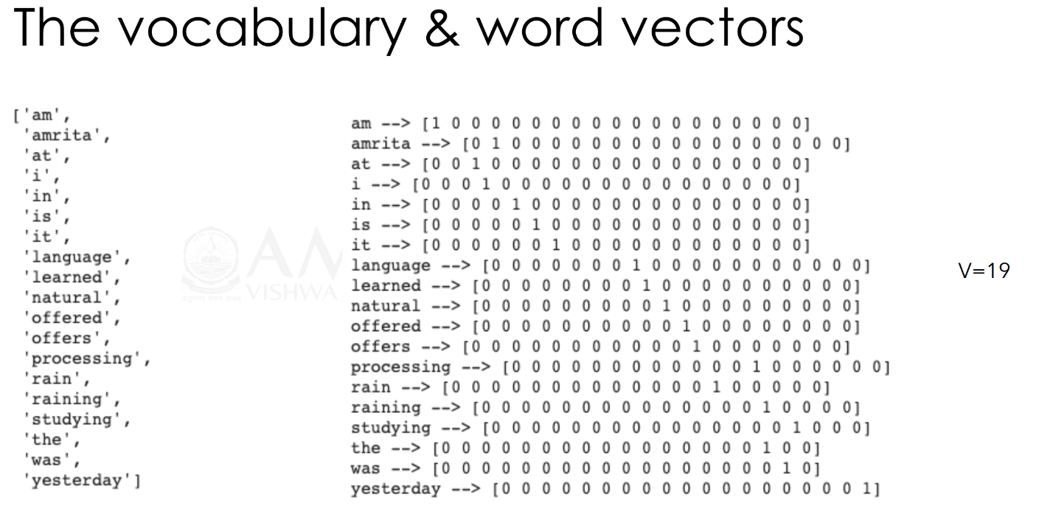

Slide 13
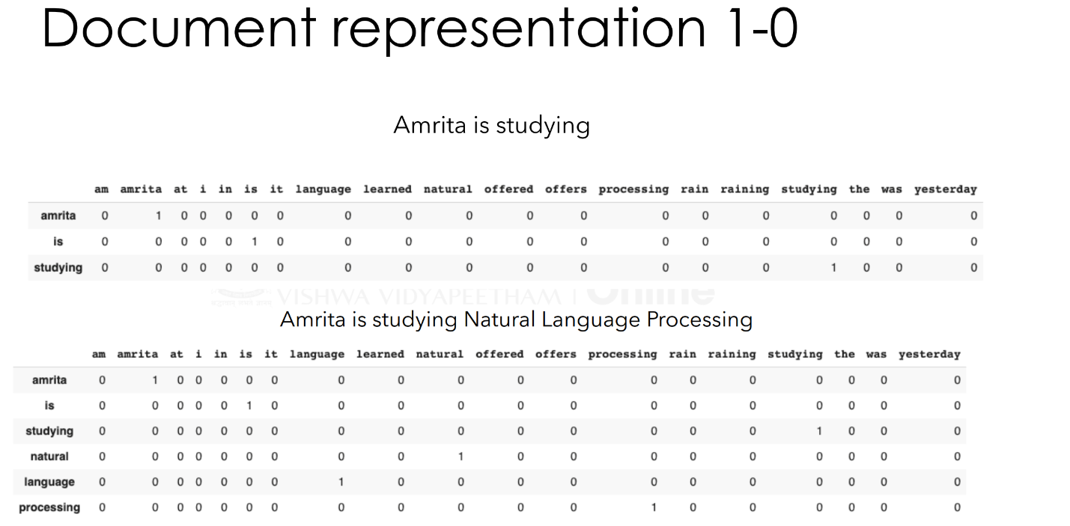

Slide 14
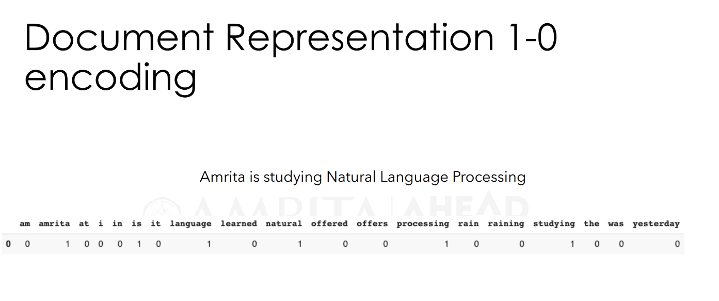

Slide 15
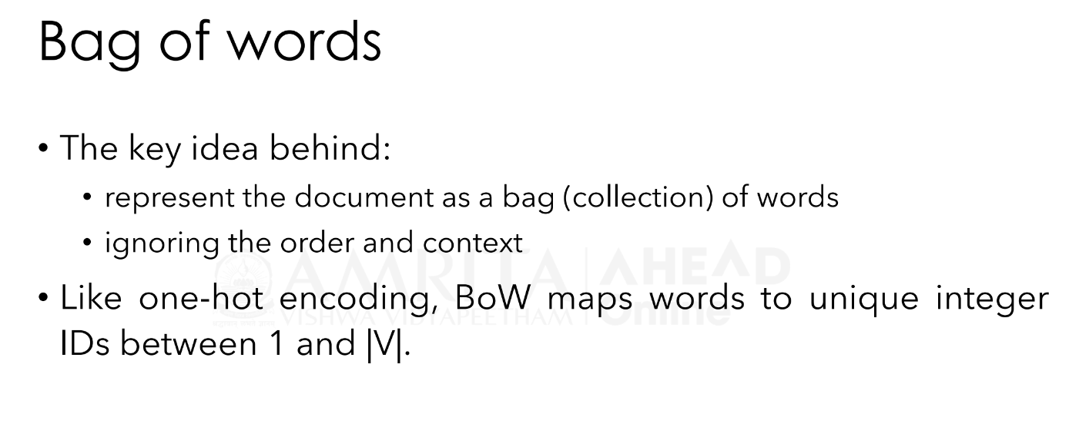

Slide 16
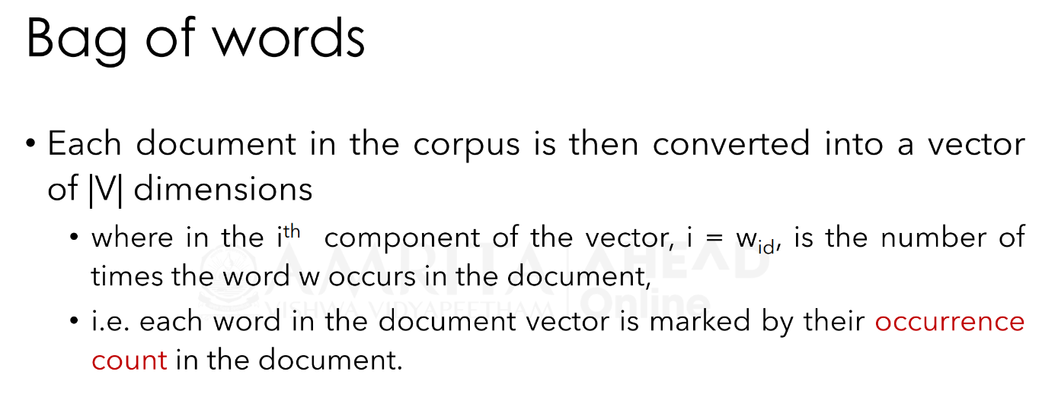

Slide 17
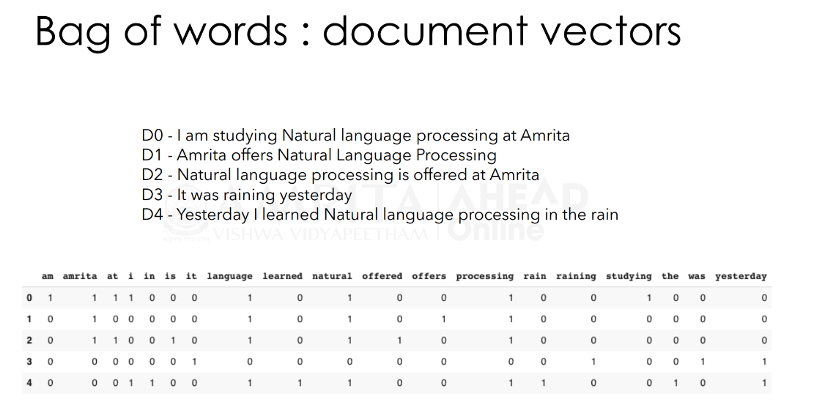

Slide 18
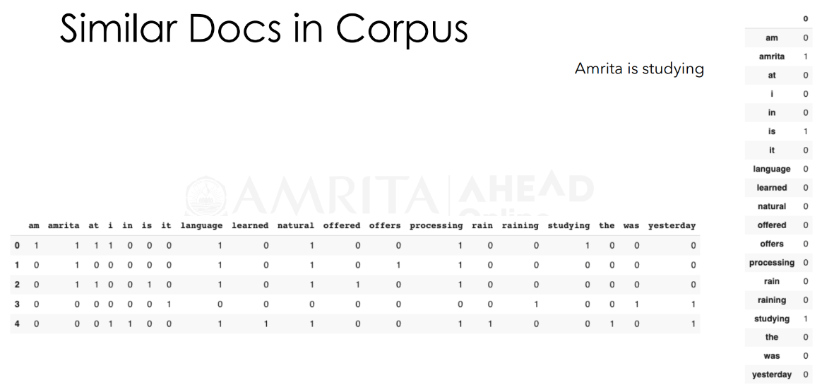

Slide 19
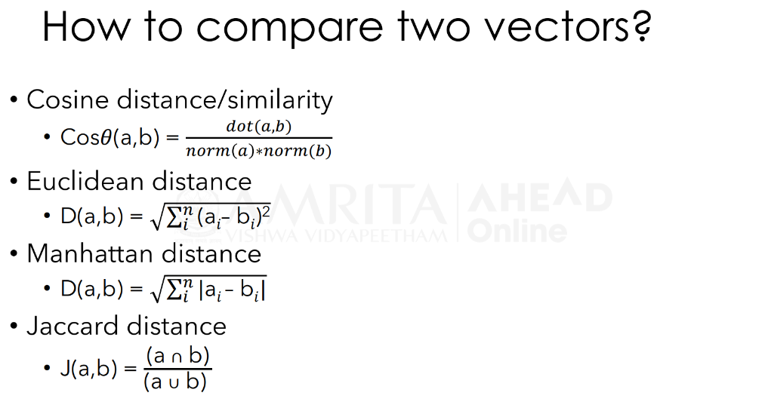

Slide 20
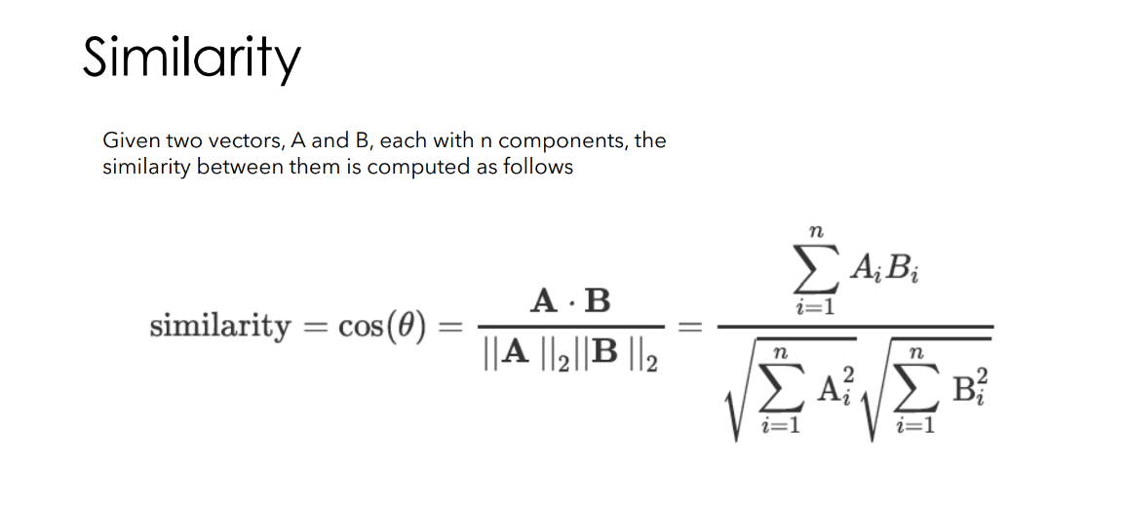

Slide 21
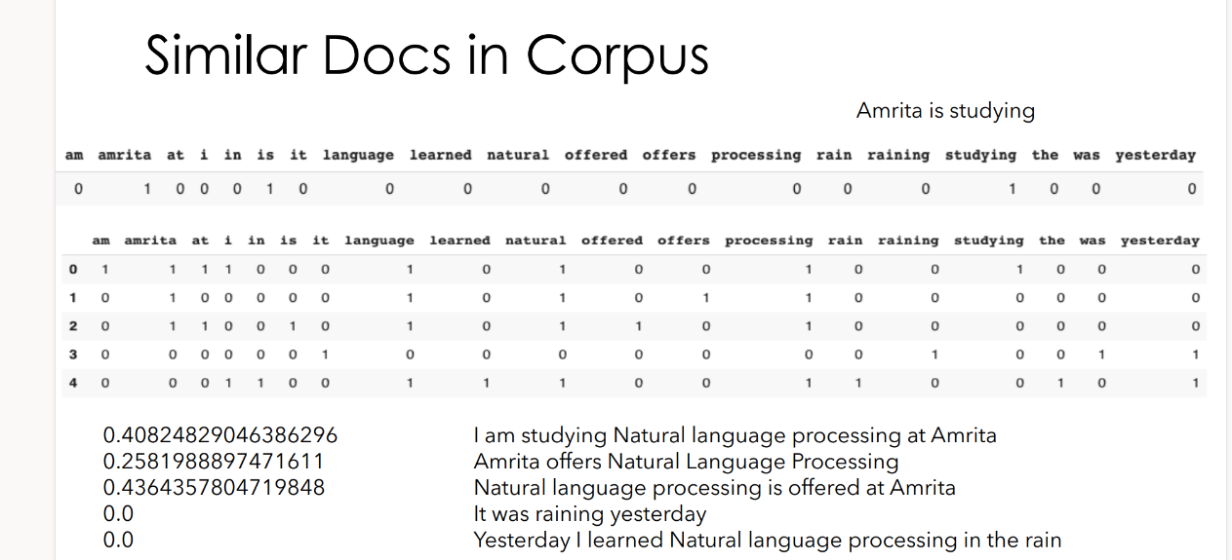

Slide 22
Advanced Vectorization technique

Slide 23
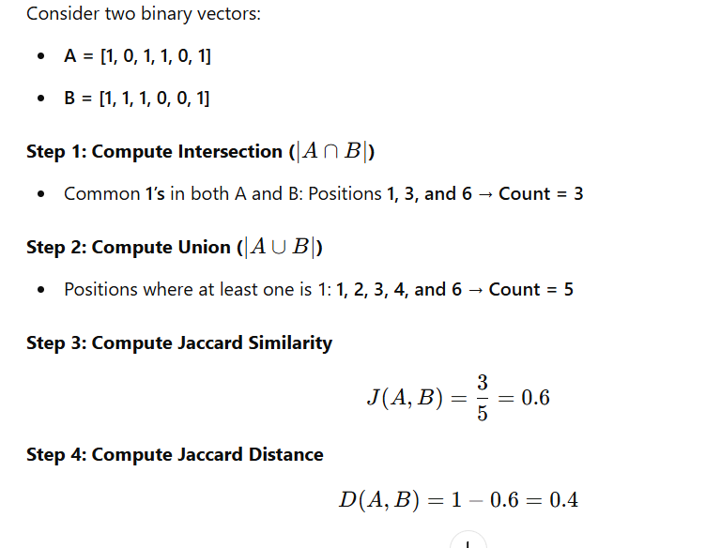

Slide 24
BoWs Limitations
The Bag of Words (BoW) model has several limitations, primarily due to its simplistic approach of representing text as word frequency counts while ignoring word order, syntax, and semantics.
It treats words independently, failing to capture contextual meaning, making it ineffective for tasks requiring deep language understanding, such as sentiment analysis and machine translation.
BoW leads to high-dimensional and sparse vectors, especially with large vocabularies, increasing computational cost.
It also struggles with synonyms and polysemy (words with multiple meanings), as it considers "great" and "excellent" as different words, even though they are semantically similar.
24

Slide 25
tf-idf vectorization
BoW : count of tokens in a document.
TF-IDF : term frequency–inverse document frequency.
Captures the importance of a given word relative to other words in the document and in the corpus.
tf-idf_{(w,d)} = tf_{(w,d)} * idf_{(w)} where
tf_{(w,d)} – term-frequency of word w in document d and
idf_{(w)} – inverse document frequency of the word w in the corpus.
25

Slide 26
tf-idf vectorization
TF : term-frequency – measures how often a term or word (w) occurs in a given document (d).
_{tf(w,d) =} count of word w in document d
total words in document
26

Slide 27
IDF
IDF : inverse document frequency - measures the importance of the term across a corpus.
DF : document frequency (w)
_{df(w) =} Count of documents that has word w
Total number of documents in the corpus
IDF : inverse of DF
_{idf(w) =} Total number of documents in the corpus
Count of documents that has word w
27

Slide 28
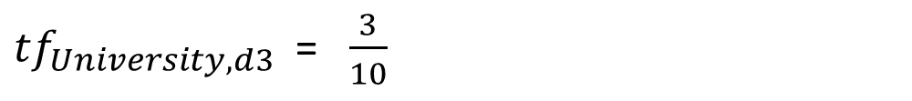
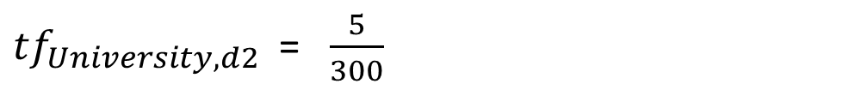
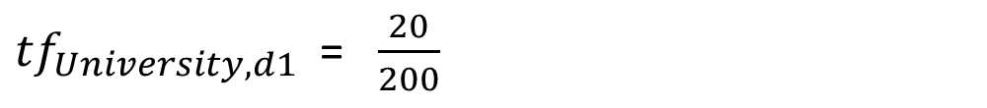
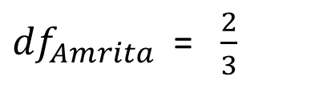
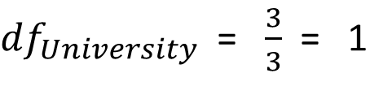
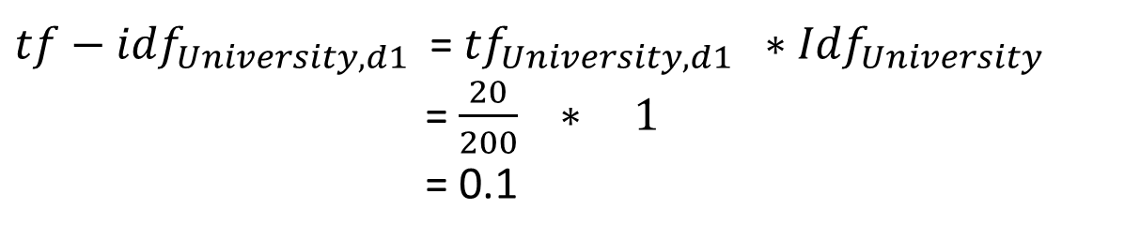
tf-idf computation
${df}_{University}$= $\frac{3}{3}$= 1
d1 – 200, d2 – 300, d3 – 10
University → d1(20), d2(5), d3 (3) Amrita → d1(10), d2(2), d3(0)
${df}_{Amrita}$= $\frac{2}{3}$
${tf}_{University,d1}$= $\frac{20}{200}$
${tf−idf}_{University,d1}$= ${tf}_{University,d1} ∗{Idf}_{University}$
= $\frac{20}{200} ∗ 1$
= 0.1
${tf}_{University,d2}$= $\frac{5}{300}$
${tf}_{University,d3}$= $\frac{3}{10}$

Slide 29
tf-idf vectorization
tf-idf_{(w,d)} = tf_{(w,d)} * idf_{(w)}
IDF : inverse of DF
_{idf(w) =log(} Total number of documents in the corpus ₎
Count of documents that has word w
log(1000/1000)=log(1)=0
Log Normalized idf
Total number of documents in the corpus
Count of documents that has word w
idf_{(w)} = log
idf_{(w)} = log
log(1000/0)
idf_{(w)} =log
+ 1
Total number of documents in the corpus Count of documents that has word w
+ 1
Total number of documents in the corpus
Count of documents that has word w+1
+ 1

Slide 30
Toy Corpus
D1 : Amrita studies at Amrita university.
D2: Amrita is a university.
D3 : She studies at Amrita.
 | document # | df | idf | log normalized
amrita | 3 | 3/3 | 1 | 1
at | 2 | 2/3 | 1.5 | 1.176091259
is | 1 | 1/3 | 3 | 1.477121255
she | 1 | 1/3 | 3 | 1.477121255
studies | 2 | 2/3 | 1.5 | 1.176091259
university | 2 | 2/3 | 1.5 | 1.176091259

Slide 31
tf-idf vectorization D1 : Amrita studies at Amrita university.
D2: Amrita is a university. D3 : She studies at Amrita.
^{tf}(w,d)
^{tf}(w,d) ^{* idf}(w)
 | D1 - 5 | D2 - 4 | D3 - 4 | idf_{(w)} | D1 |  | D2 | D3
amrita | 0.40 | 0.33 | 0.25 | 1.000 |  | 0.400 | 0.333 | 0.250
at | 0.20 | 0.00 | 0.25 | 1.176 |  | 0.235 | 0.000 | 0.294
is | 0.00 | 0.33 | 0.00 | 1.477 |  | 0.000 | 0.492 | 0.000
she | 0.00 | 0.00 | 0.25 | 1.477 |  | 0.000 | 0.000 | 0.369
studies | 0.20 | 0.00 | 0.25 | 1.176 |  | 0.235 | 0.000 | 0.294
university | 0.20 | 0.33 | 0.00 | 1.176 |  | 0.235 | 0.392 | 0.000

Slide 32
N-gram Vectorization

Slide 33
n-gram Language Models
Tokens are not always single words:
Natural Language Processing → 3 tokens
New Delhi → 2 tokens
Social media → 2 tokens
Not good → 2 tokens
n-gram modelling will capture such word combinations making them as one token.
N-grams are the combinations of multiple characters or multiple words.

Slide 34
n-gram Language Models
They are formed : the previous and next words are captured.
Unigrams are the unique words present in the sentence.
Bigram is the combination of 2 words.
Trigram is 3 words and so on.
ngrams is n consecutive words
Eg: “I study at Amrita University”
Unigrams: “I”, “study”, “at”, “Amrita”, “University”
Bigrams: “I study”, “study at”, “at Amrita”, “Amrita University”
Trigrams: “I study at”, “study at Amrita”, “at Amrita University”

Slide 35
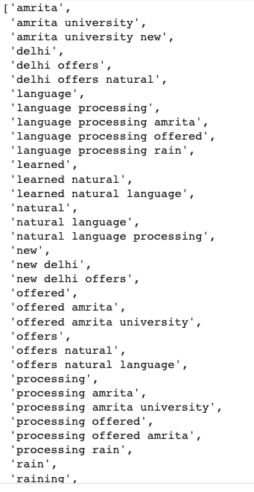
Toy Corpus , n-gram vocabulary
text1 = I am studying Natural language processing
at Amrita University.
text2 = Amrita University at New Delhi offers Natural Language Processing.
text3 = It was raining yesterday in New Delhi.
text4 = Natural language processing is offered at
Amrita University.
text5 = Yesterday I learned Natural language processing in the rain.

Slide 36
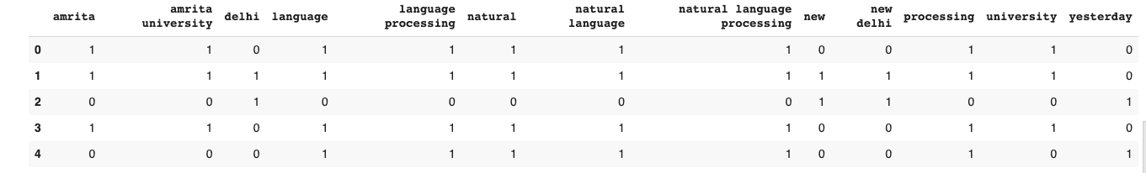
N-gram document vectors

Slide 37
Word Embeddings

Slide 38
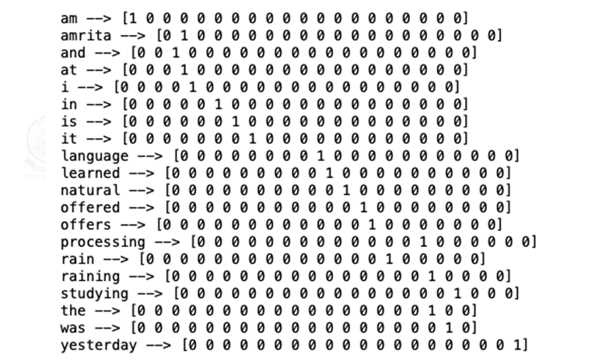
One-hot Encoding → Word Vector
Similarity between word vectors

Slide 39
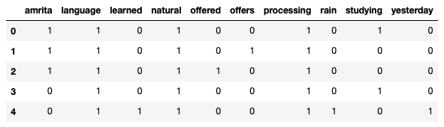
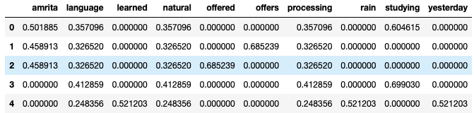
BoW and Tf-idf → Document Vectors

Slide 40
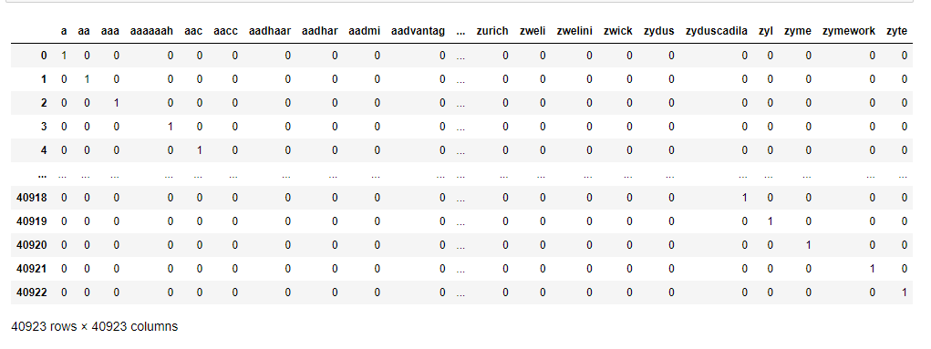
1-0 big corpus

Slide 41
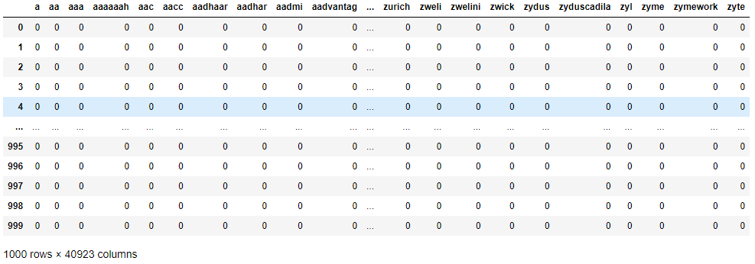
BoWs – big corpus

Slide 42
Limitations of Basic Vectorization
Long
Sparse
Does not convey any semantic information
Solution : Distribution Representations with Word Embeddings
Short
Dense
Capture the semantic similarity – vectors with sense

Slide 43
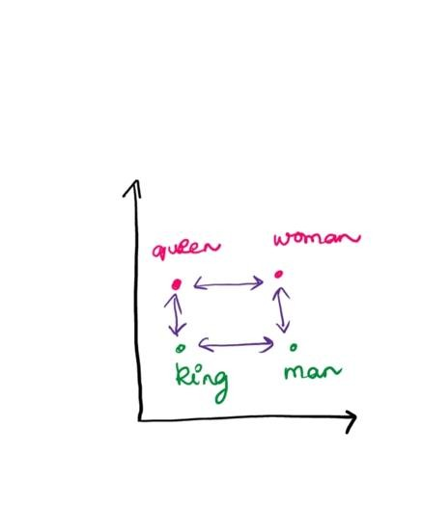
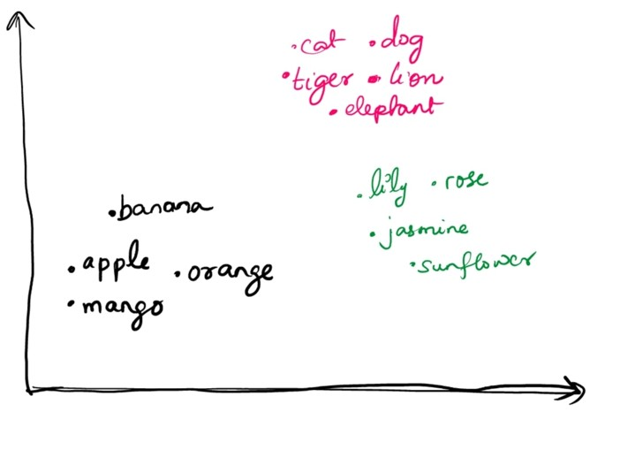
Vectors with sense?
king — man + woman = queen
https://developers.google.com/

Slide 44











Vectors with Sense
Queen | 0.9 | 0.9 | 0.1
King | 0.9 | 0.1 | 0.9
Woman | 0.1 | 0.9 | 0.1
Man | 0.1 | 0.1 | 0.9
King – Man + Woman = ?
Queen
0.9
0.1
0.9
0.1
0.1
0.9
0.1
0.9
0.1
0.8
0
0
0.1
0.9
0.1
0.9
0.9
0.1
Solution : Advanced Vectorization - Distribution Representation Word Embeddings
Content Credits: Dr. Premjith, CEN, Amrita University

Slide 45
Advanced Vectorization : Distribution Representation
Word Embeddings :
Create a real-valued vector that encodes the meaning of the word
Such that the words that are closer in the vector space are expected to be similar in meaning.
Words with similar meaning will have similar vector representation.
The vectors of ‘apple’, ‘mango’ should be similar as compared with the vector of ‘student’.

Slide 46
Word Embeddings : Created?
Sparse vector representations of words will be transformed into a dense vector space.
Transformation : neural networks, dimensionality reduction on the word co-occurrence matrix, probabilistic models ….
Pre-trained embeddings are
Word2vec by Google
GloVe by Stanford
fasttext embeddings by Facebook
BERT : contextual embeddings

